Slide 1
Requirements Analysis Concepts & Principles

Slide 2
Requirements Analysis and Specification
Many projects fail:
  because they start implementing the system:
  without determining whether they are building what the customer really wants.

Slide 3
System
Study/understanding
Software
Requirements
Analysis
Software
Design

Slide 4
Problem study
User response
User response
Problem Analysis
A relatively good understanding of user’s
requirements
System Description
Software Requirements Specification

Slide 5
SW Requirements Analysis
A study of user needs, for a problem to arrive at a definition of WHAT the software will do without describing how it will do it.
A Software Requirements Specification (SRS) is a document containing software requirements specification for a system.

Slide 6
Requirements Analysis Activities
Study System Specification, SW Project plan & feasibility report
Problem Recognition
Evaluation & understanding
Modeling
Specification
Review

Slide 7
Requirement Elicitation
  Fact Gathering Techniques
  Interviews
  Questionnaires
  Analyzing documents
  Observation
  study...

Slide 8
Facilitated Application Specification Technique
Requirement Elicitation contd.
Meeting at neutral site
Rules for preparation & participation
Agenda – formal + informal
Facilitator controls meeting
Definition mechanism
Identify problem, propose solution, negotiate approaches, specify set of solution requirements

Slide 9
Quality Function Deployment - quality management technique
Requirement Elicitation contd.
Normal requirements
Expected requirements
Other requirements
Function Deployment : function values
Information Deployment : data objects + events
Task deployment : system behavior
Value Analysis : requirement priorities

Slide 10
Use Case diagram (usage scenario of HR department)
Requirement Elicitation contd.
<<uses>>
Approves
leave
Validates
leave
Manages
Projects
Manager
Approves
vouchers

Slide 11
Requirement Elicitation contd.
Scenarios viewed differently by different actors
Use U_C Modeling : Priority value assigned for each use case
System functionality with priorities

Slide 12
Analysis Principles
Information domain must be represented thoroughly
Functions to perform, must be defined and modeled properly
Behavior, as consequence of external events must be represented correctly
Models depicting information/data, function & behavior must be partitioned to uncover detail in layered fashion ( i.e. step by step)
Analysis process should move from essential information (i.e. most abstract level) to implementation (most detailed) level.

Slide 13
Analysis Principles
Understand the problem clearly before creating analysis and design model
Develop prototypes
Record the origin & the reason for every requirement (trace)
Use multiple views of requirements
Rank (prioritize) all requirements
Work to eliminate ambiguity in requirements if any

Slide 14
Information Domain
Analysis Principles (contd.)
Information contents & relationships (Data Model)
Information Flow ( data flow)
Information structure (data dictionary) and internal organization of data (data structure)

Slide 15
Analysis Principles (contd.)
Various models of Structured Analysis
Functional Model (DFD)
Structural Model (ERD)
Behavioral Model (time dependant behavior) (STD)

Slide 16
Modeling
A model is an abstract representation of a view of the system
Build different models of the system to view it from various ways/angles
Benefits of modeling
  focuses on important features of the system while avoiding less important features
  discuss changes and corrections to the user’s requirements with low cost and minimal risk
  verify that Analyst correctly understands the user’s requirements

Slide 17
Analysis Models
State-transition
Diagram
Data object description
Process Specification
Entity
Relationship
diagram
Data flow
diagram
Data
Dictionary
Control Specification

Slide 18
Analysis Models
Data Flow Diagram functional view
Entity Relationship Stored Data view
Diagram
State Transition Time-dependent
Diagram behavioral view

Slide 19
Data Flow Diagram (DFD)
A DFD depicts the flow of information within a system and between the system and the outside world.
It does not show sequence and control information.
A Data Flow Diagram (DFD) contains:
  External entities, Processes, Data flows,
  Data stores

Slide 20
LEVEL 0 DFD for Mess Management System
STUDENTS
REBATES
/ EXTRAS NOTE
REQUISITIONS
VENDORS
SUPPLIES
PAYMENTS
PAYMENTS
MESS MANAGEMENT SYSTEM
BILLS
DAILY RATE
MESS SECRATORY
PERISHABLE ITEMS
MENU
OVER DUE BILLS
OVERDUE
PAYMENTS TO VENDORS
CHIEF WARDEN
MESS MANAGER
ITEMS NEEDED
EACH DAY

Slide 21
DFD Example (LIS Level 2)
Books
Publishers
Orders
PO
Librarian
Verify Order
Assemble PO
Publisher
Pending Orders
Customer
Fulfilled Orders
Pending Orders

Slide 22
DFD Primitives
External Entity represents a source or sink for data. These are usually outside the scope of the area under study.
Process transforms or manipulates data
Data flow carries data between an entity
and a process, a process and a store,
or between two processes
Data Store represents a repository of data
Connector symbols are used if the diagram spans multiple pages.

Slide 23
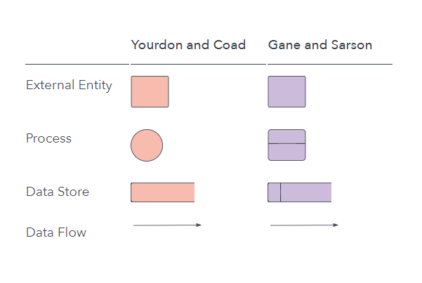

Slide 24
Types of DFDs
Current Physical DFD
produced in the early stages of analysis
to describe the existing system.
Current Logical DFD
derived from the above, after removing
physical elements.

Slide 25
Example: Current Physical DFD
OrderForm
Sales
OCopy 4,5
Warehouse
OCopy5
Create Order
Select Goods
OCopy1
OCopy4
Cust Folder
BinCards
Delivery Folder
OrderFile (Copy2,3)
Inv
Copy2
Sales
Accounts
Signed
OCopy5
Raise Invoice
File Invoice
Warehouse
OCopy5
Confirm Delv.
InvCopy1
CompletedOrders
InvCopy2
Cust Folder
Delivery Folder

Slide 26
Example: Current Logical DFD
(online shopping store Level 2)
Delivery
Order
Order
Create Order
Select Goods
credit
status
Customer
ItemStock
Order
Order
Accepted
Order
Invoice
Create Invoice
Confirm Delv.
Order
Invoice

Slide 27
DFD Hierarchy
DFD can be used at different levels of abstraction.
The highest level DFD is called a Context Diagram
A process may be exploded into a lower level DFD to show more detail.
In such a case, the net input and output flows must be balanced across the DFD levels.
When decomposing a DFD, you must protect inputs to and outputs from a process at the next level of decomposition. This is called balancing.
The lower level DFD may have data stores that are local to it, and not shown in the higher level DFD.

Slide 28
Context Diagram (DFD Level 0)
Example: Context Diagram
Represents an entire system
as a single process
Shows the scope of the system
Highlights the interfaces
between the system and
the outside terminators
(external entities)
The
System

Slide 29
Leveled DFDs
Context Diagram
Level-1 DFD
The
System
1 *
2 *
3
Level-2 DFD
3.1 *
3.2 *

Slide 30
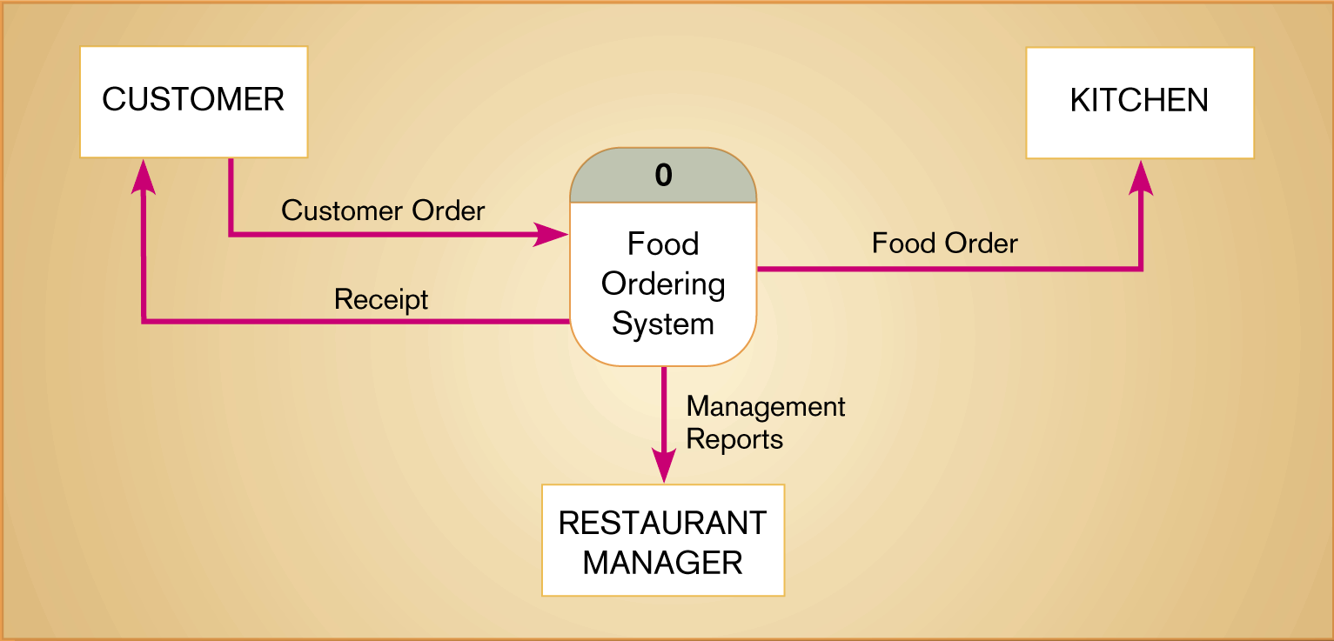
Context diagram of food ordering system

Slide 31
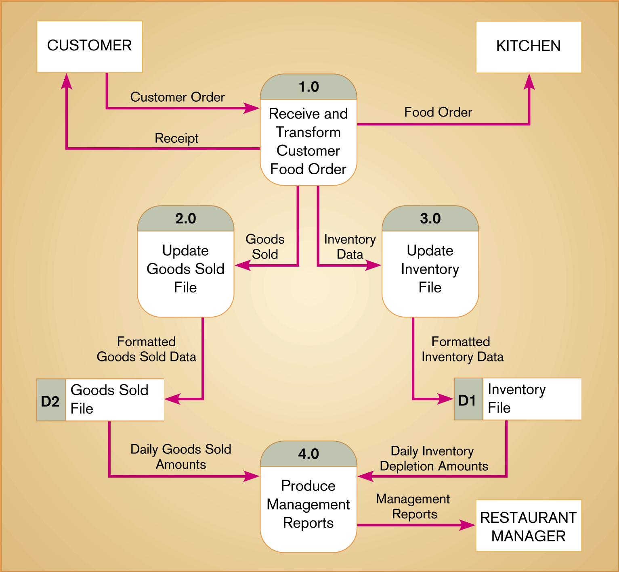
Level-1 DFD of food ordering system

Slide 32
DFD Guidelines
Ideally, a DFD at any level, should have no more than half of a dozen processes and related stores.
Choose meaningful names for processes, flows, stores, and terminators
  use active unambiguous verbs for process names such as Issue, Purchase, Create, Calculate, Compute, Produce, etc.
Number the processes

Slide 33
DFD Guidelines (continue..)
Make sure that DFD is internally consistent
  avoid infinite sinks
  avoid spontaneous generation of processes
  beware of unlabeled flows and unlabeled processes
  beware of read-only or write-only stores

Slide 34
DFD Guidelines (continue..)
Avoid overly complex DFDs
Balance DFDs across the levels
Data flows and stores must be described in the Data dictionary.
Processes must be supported either by a lower level DFD or a mini-specification (algorithm).

Slide 35
Lowest Level Processes in a DFD
A process that cannot be exploded further has an associated mini specification.
Mini spec can be in:
  Structured English
  Decision Table/Decision Tree

Slide 36
Example: Process Specification in
Structured English (with proper indentation)
FOR EACH item in the Indent DO
IF Item is on Rate-Contract
prepare PO to Rate-Contract vendor
ELSE IF Item is proprietary
prepare PO to manufacturer
ELSE
prepare regular PO to registered vendor
END FOR

Slide 37
Modeling Logic with
Decision Tables
A matrix (tabular) representation of the logic of a decision
Specifies the possible conditions and the resulting actions
Best used for complicated decision logic

Slide 38
Modeling Logic with
Decision Tables
Consists of three parts
  Condition stubs
    Lists condition relevant to decision
  Action stubs
    Actions that result from a given set of conditions
  Rules
    Specify which actions are to be followed for a given set of conditions

Slide 39
Modeling Logic with
Decision Tables
Standard procedure for creating decision tables
  Name the condition and values each condition can assume
  Name all possible actions that can occur
  List all rules
  Define the actions for each rule
  Mark each entry in the table
9.<number>

Slide 40
A decision table is a table composed of rows and columns, separated into four separate quadrants.
Conditions Condition Rules
Actions Action Entries
The upper left quadrant contains the conditions.
The upper right quadrant contains the condition rules or alternatives. The lower left quadrant contains the actions to be taken and the lower right quadrant contains the action rules entries.

Slide 41
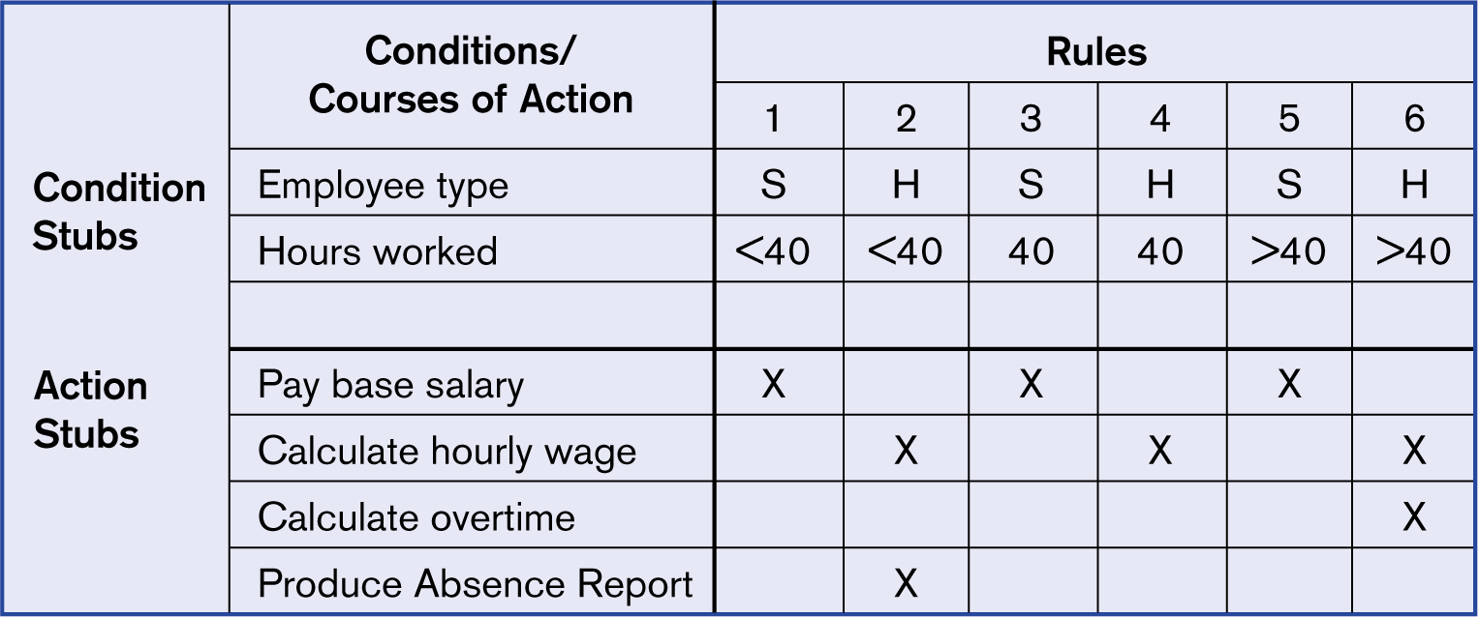
Example decision table for payroll system example
S- regular Serving employee, H- Hired employee on contract

Slide 42
Example: Decision Table (customer care system)
Conditions
Good payment record
Order Cost>Rs 1 lac
Membership > 5yrs
y
y
y
y
n
n
n
n
y
y
n
n
y
y
n
n
y
n
y
n
y
n
y
n
Actions
Priority treatment
Normal treatment
X
X
X
X
X
X
X
X

Slide 43
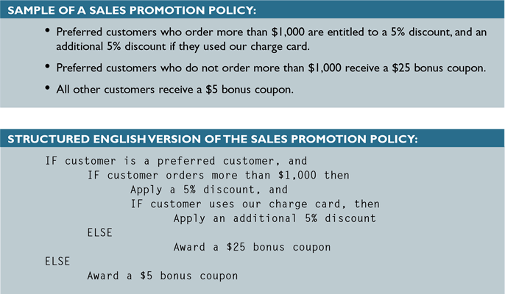
Process Description Tools
Structured English
  Might look familiar because it resembles pseudocode

Slide 44
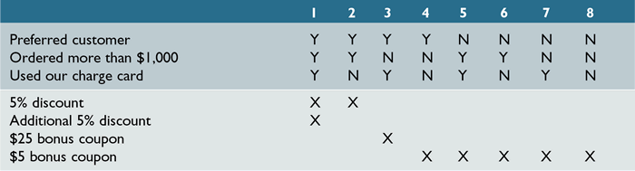
Process Description Tools
Decision Tables
  Can have more than two possible outcomes
  Often are the best way to describe a complex set of conditions

Slide 45
Example: Current Logical DFD
(online shopping store Level 2)
Delivery
Order
Order
Create Order
Select Goods
credit
status
Customer
ItemStock
Order
Order
Accepted
Order
Invoice
Create Invoice
Confirm Delv.
Order
Invoice

Slide 46
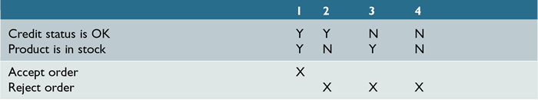
Process Description Tools
Decision Tables
  Shows a logical structure, with all possible combinations of conditions and resulting actions
  It is important to consider every possible outcome to ensure that you have overlooked nothing

Slide 47
Data Modeling
Entity Relationship Diagram (ERD)
It gives a logical view of the data and the relationships between them in a system.
Major components:
  Entities
  Relationships between entities
  Cardinality
    one-to-one recursive relationship
    one-to-many super type -subtype
    many-to-many

Slide 48
Example: ERD
places
Member
Order
setup_for
Product

Slide 49
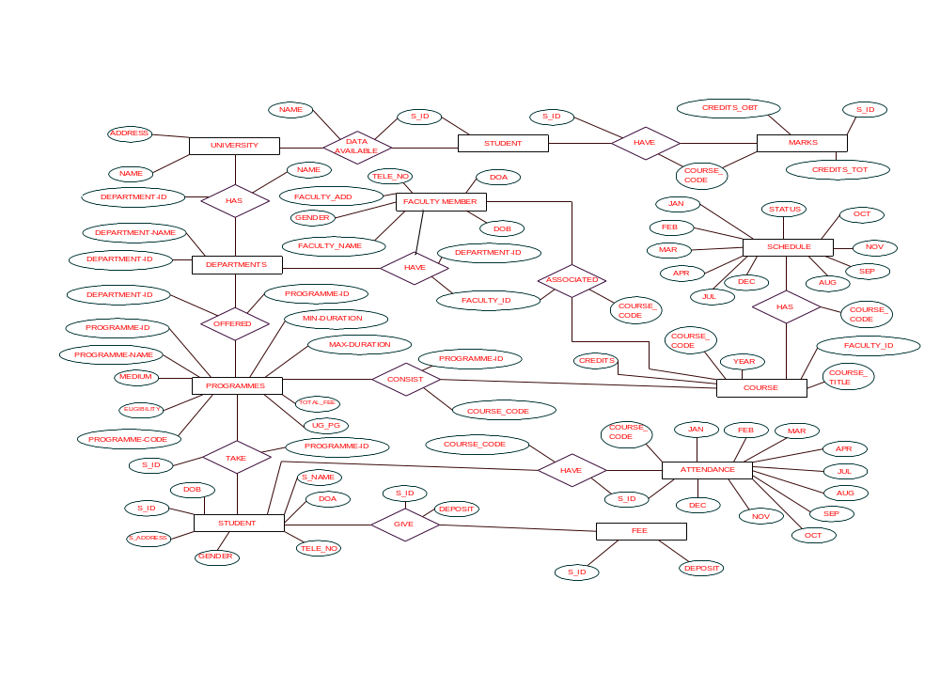

Slide 50
The Data Dictionary
The data dictionary is an organized listing of all data elements pertinent to the system with precise rigorous definitions so that both user and SA will have common understanding of all data elements.
It describes:
  meaning and composition of data flows,
  data stores
  relevant values and units of elementary data elements
  details of relationships between stores that are highlighted in a ERD

Slide 51
Data Dictionary Notation
Example:
customer-name = title + first-name +
(middle-name) + last-name
title = [Mr. | Miss | Ms. | Mrs.| Dr. | Prof. ]
first-name = {legal-character}
order = customer-name + shipping-addr
+ {item}

Slide 52
D D…
= is composed of
+ and
[ | ] either / or
{} repetition of (string)
() optional data
*---* for comments

Slide 53
Modeling Time-Dependent System Behavior
State Transition Diagram
Entity Life Histories

Slide 54
State Transition Diagram (STD)
It highlights the time-dependent behavior of a system.
It shows ‘what’ happens ‘when’
Major components
  States
  Transitions between states
Useful for describing behavior of
  real-time systems, interactive systems

Slide 55
State Transition Diagram…
The state transition diagram (std) represents the behavior of a system by displaying it’s states and the events which cause system to change its state.
STD indicates what actions are taken as a consequence of a particular event.

Slide 56
Example: State Transition Diagram
RButton-down
/ display PopUp Menu
Idle
Menu visible
RButton-up
/ erase PopUp Menu
Cursor-moved
/ highlight Menu item

Slide 57
STD for photocopier software
Full and start
idle
Invoke manage copying
Invoke read -op-input
Reading
commands
full
Copies done
Invoke read-op-input
Invoke read-op-input
Making
copies
Reloading
paper
empty
Invoke reload paper
Jammed
Invoke perform problem diagnosis
Not jammed
Diagnosing
problems
Invoke read op-input

Slide 58
Statechart Diagrams (ex. Digital Watch )
State
Event
Initial state
button1&2Pressed
button2Pressed
Blink
Increment
Hours
Hours
Transition
button1Pressed
button1&2Pressed
Blink
button2Pressed
Increment
Minutes
Minutes
button1Pressed
button2Pressed
Stop
Blink
Increment
Blinking
Seconds
Seconds
Final state
button1&2Pressed

Slide 59
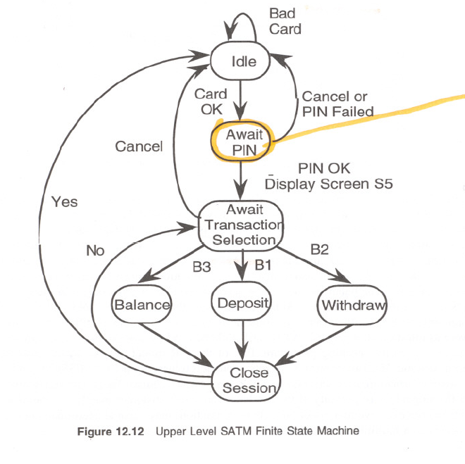
FIGURE 12.12
H.Reza

Slide 60
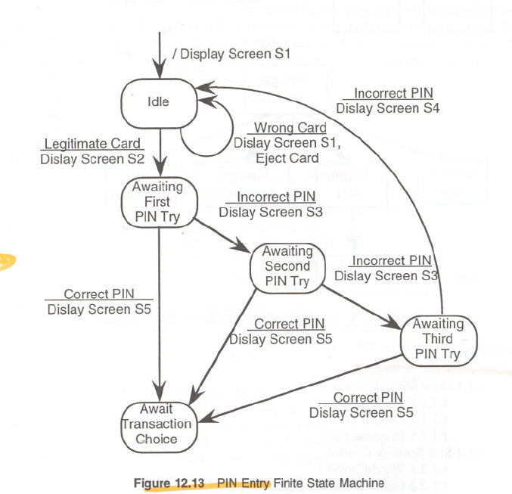
FIGURE 12.13
H.Reza

Slide 61
Entity Life History (ELH)
An ELH represents all the permitted sequences of events that may occur during the life of an occurrence of an entity.
An Event may effect entity occurrences
An effect can be to:
  Create, Modify, Delete
To construct ELH, first construct Entity/Event Matrix

Slide 62
Example: Entity Life History
Entity
Member
New Member Appl
Member Det. Changed
Membership
expired
Events

Slide 63
Cross Checking the different Models
Balancing ERD against the DFD, Process specs.
Balancing DFD against the STD
Balancing ERD against Data dictionary
Balancing DFD against Data dictionary

Slide 64
Balancing ERD and DFD, Process Specs.
Every store on the DFD must correspond to an entity or a relationship or a combination of an entity and relationship on the ERD.
Entity names on the ERD and data store names on the DFD must match.
The data dictionary entries must apply to both the DFD and the ERD data elements.

Slide 65
Function Based Metrics (check pints) for analysis model
Needs reliable backup/recovery?
Needs data communications?
Are there distributed processing functions?
Is performance critical?
System runs in existing heavily utilized operational environment?
System requires on-line data entry?
On-line entry requires I/p transaction over multiple screens/operations?

Slide 66
Continue…
Are master files updated on line?
Are I/Ps ,O/Ps , files or enquiries complex?
Is the internal processing complex?
Is the code designed to be reusable?
Are conversion & installation included in the design?
Is system designed for multiple installations in diff. Organizations?
Is application designed to facilitate change & ease of use by the user?

Slide 67
Function Based Metrics for analysis model
Quantitative representation
Scale 0 – 5
(not important/applicable) - (absolutely essential)
Errors/FP
Defects/FP
$ (rate)/FP
Pages of documentation/FP
FP/person-month

Slide 68
The Basic Metric for analysis model
Functional Primitives (FuP)
No. of transformations on lowest level DFD
Data Elements (DE)
No. of attributes of a data object
Objects (OB)
No. of data objects
Relationships (RE)
No. of connections between data objects
States (ST)
No. of user observable states in STD
Transitions (TR)
No. of state transitions in STD

